Slide 1


Course Code: HSS 461
Class: 5th Sem.
Course Title: Accounts & Finance
Class Day: Wednesday Timing:
2:30pm to 04:30am
Lecture / Week No. 6
Instructor Name: Asim Iqbal
BAHRIA UNIVERSITY
Computer & Software Engineering Department

Slide 2
Table Of Contents
S.R# | Contents | Page #
1. | Prepare an accounting worksheet | 9
2. | Use the worksheet to prepare financial statements | 19
3. | Close the revenue, expense, and drawing accounts | 26
4. | Prepare post-closing trial balance | 34
5. | Classify assets and liabilities as current or long-term | 38
6. | Use the current ratio and the debt ratio to evaluate a company | 48
7. | Chapter 4 Summary | 53
8. | Reference | 59

Slide 3

Completing the Accounting Cycle
Chapter 4
Notes:
Chapter 4 depicts the completion of the accounting cycle.

Slide 4




Learning Objectives
 | Prepare an accounting worksheet
 | Use the worksheet to prepare financial statements
 | Close the revenue, expense, and drawing accounts
 | Prepare the post-closing trial balance
Notes:
The objectives for this chapter include to:
1. Prepare an accounting worksheet.
2. Use the worksheet to prepare financial statements.
3. Close the revenue, expense, and drawing accounts.
4. Prepare the post-closing trial balance.

Slide 5



Learning Objectives
 | Classify assets and liabilities as current or long-term
 | Describe the effect of various transactions on the current ratio and the debt ratio
 | Understand reversing entries (see Appendix 4A, located at myaccountinglab.com)
Notes:
Additional objectives include to:
5. Classify assets and liabilities as current or long-term.
6. Describe the effect of various transactions on the current ratio and the debt ratio.
7. Understand reversing entries (see Appendix 4A, located at myaccountinglab.com).

Slide 6
The Accounting Cycle
Process used to produce financial statements
A worksheet summarizes needed data
Cycle begins with Assets = Liabilities + Equity and revenues and expenses set equal zero
Accounting occurs:
During the period
At the end of the period
Notes:
Should companies start month 2 with the net income that the business earned last month? No, just like a game, companies must start from zero in order to measure their business performance in the second month. Therefore, they must set their accounting scoreboard back to zero. This process of getting back to zero is called closing the books, and it is the last step in the accounting cycle.
The accounting cycle is the process by which companies produce their financial statements. Worksheets help by summarizing lots of data in one place. Accounting takes place at two different times:
● During the period—Journalizing transactions, posting to the accounts
● At the end of the period—Adjusting the accounts, closing the accounts, preparing the financial statements, and closing the accounts

Slide 7
Accounting Cycle
Journalize Transaction
During the period
Post to Accounts
Adjust Accounts
At the end of the period
Prepare
Financial Statements
Close Accounts
Notes:
The accounting cycle starts with the beginning asset, liability, and stockholders’ equity account balances left over from the preceding period. During the period, transactions are journalized and then posted to the accounts. At the end of the period, accounts are adjusted, financial statements are prepared, and then the accounts are closed.

Slide 8
Steps in the Accounting Cycle
Start with the beginning account balances.
Analyze and journalize transactions as they occur.
Compute the unadjusted balance in each account.
Enter the trial balance and complete the worksheet. Journalize and post adjusting entries
Prepare the post-closing
trial balance.
Post to the accounts.
Prepare the financial
statements.
Journalize and post the closing entries.
Notes:
There are 8 steps in the accounting cycle.
Start with beginning account balances: Assets = Liabilities + Equity.
Analyze and journalize transactions as they occur during the entire period.
Post from the journal to the ledger.
At the end of the period, compute the unadjusted trial balance for each account.
Optional – Enter the trial balance on the worksheet, complete the worksheet by entering adjustments. Journalize and post the adjusting entries.
Prepare the financial statements.
Journalize and post the closing entries.
Prepare the post-closing trial balance.
Then, a new cycle begins.

Slide 9
1
Prepare an accounting worksheet
Notes:
The first learning objective is to prepare an accounting worksheet.

Slide 10

Worksheet
A tool used to summarize information
NOT:
A journal
A ledger
A financial statement
Computerized spreadsheets work well
Contains heading similar to statements
Notes:
Accountants often use a worksheet—a document with several columns—to summarize data for the financial statements. The worksheet is not a journal, a ledger, or a financial statement. It is merely a summary device that helps identify the accounts that need adjustment. An Excel spreadsheet works well for preparing a worksheet. Note that the worksheet is an internal document. It is not meant to be given to outsiders.

Slide 11
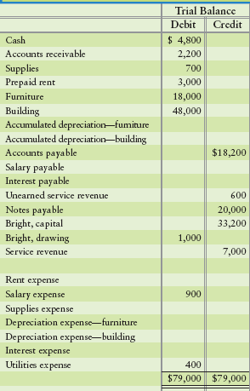
Worksheet Step 1
Enter
account titles
unadjusted balances
Total the amounts
11
Notes:
Enter the account titles and their unadjusted balances in the trial balance columns of the work sheet, and total the amounts. Data comes from the ledger accounts before any adjustments. Accounts are listed in proper order (Cash first, Accounts receivable second, and so on). Total debits must equal total credits.

Slide 12
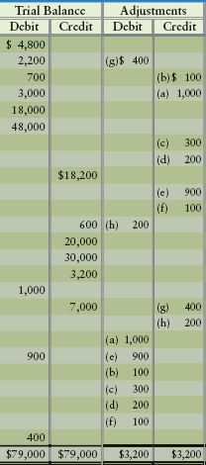
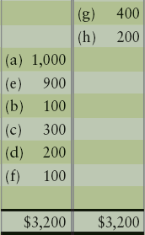
Worksheet Step 2
Enter the adjusting entries
Total the amounts
Notes:
Enter the adjusting entries in the adjustments columns, and total the amounts. Letters are used to identify which debit belongs with which credit.

Slide 13
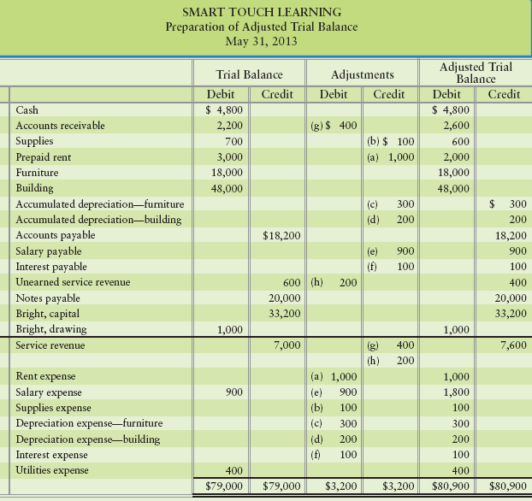
Worksheet Step 3
$2,200 (Dr) + $400 (Dr) = $2,600
$600 (Cr) - $200 (Dr) = $400
Compute account’s adjusted balance
Enter the adjusted balance in the Adjusted trial balance column
Notes:
Compute each account’s adjusted balance by combining the trial balance and adjustment figures and carry that total to the adjusted trial balance, as appropriate. Here is the worksheet with the adjusted trial balance completed. For example, Cash is never adjusted. Accounts receivable’s adjusted balance of $2,600 is computed by adding the unadjusted amount of $2,200 to the $400 adjustment. For Unearned service revenue, we subtract the $200 debit adjustment from the unadjusted credit balance of $600 and have an adjusted balance of $400. As on the trial balance, total debits must equal total credits on the adjusted trial balance after totaling all accounts.

Slide 14
Worksheet Step 4
Draw an imaginary line above the revenue account
Accounts above the line are Balance sheet accounts
Accounts below the line are Income Statement accounts
Assets
Liabilities
Equity
Revenue
Expenses
Notes:
Draw an imaginary line above the first revenue account (in this case, Service revenue). Every account above that line (assets, liabilities, and equity accounts) is copied from the adjusted trial balance to the balance sheet columns. Every account below the line (revenues and expenses) is copied from the adjusted trial balance to the income statement columns. Each account’s balance should appear in only one column.

Slide 15
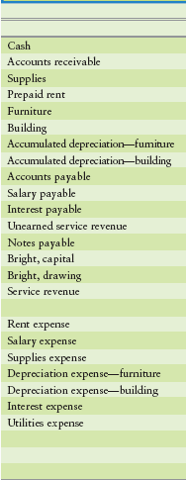
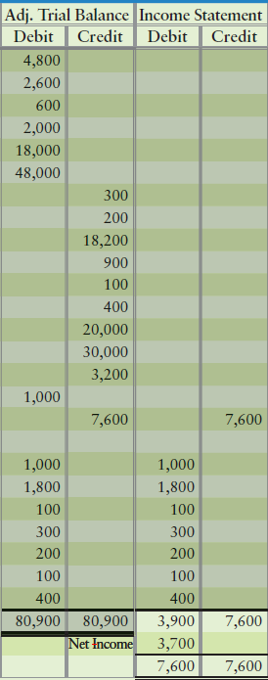
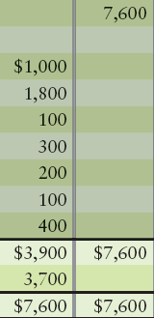
Worksheet Step 5
Using the income statement columns, compute net income
Revenues minus expenses
Enter net income as the balancing amount
Revenues total = $7,600
Expenses total = $3,900
Net Income = $3,700
Notes:
On the income statement, compute net income or net loss as total revenues minus total expenses. Enter net income as the balancing amount on the income statement. Always total the columns.

Slide 16
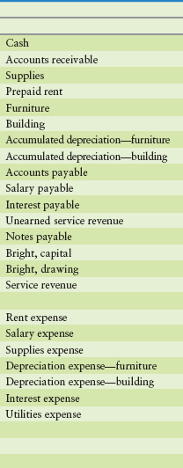
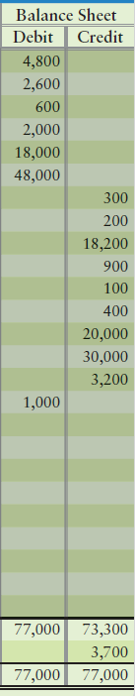
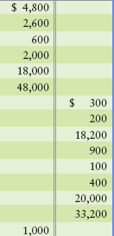
Worksheet Step 5
Also enter net income as a balancing amount in the balance sheet columns
Net income from previous columns
Notes:
Also enter net income (loss) as the balancing amount on the balance sheet. Then total the financial statement columns. Always total the columns to make them balance.

Slide 17
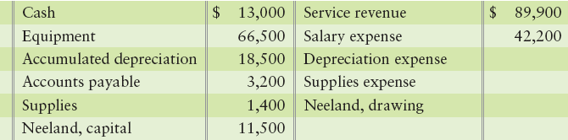
E4-12: Preparing a worksheet
Data for the unadjusted trial balance of Mexican Riviera Tanning Salon at March 31, 2012, follow.
Adjusting data for March 2012 are:
Les Neeland, the principal stockholder, has received an offer to sell the company. He needs to know the net income for the month covered by these data.
1. Prepare the worksheet for Mexican Riviera Tanning Salon.
2. How much was the net income/net loss for March?
a. Accrued service revenue, $2,600. c. Accrued salary expense, $1,700.
b. Supplies used in operations, $400. d. Depreciation expense, $4,100.
Notes:
Exercise 4-12 focuses on preparing a worksheet.

Slide 18
E4-12: Preparing a worksheet
ACCOUNT TITLE | ADJUSTED TRIAL BALANCE |  | INCOME STATEMENT |  | BALANCE SHEET
 | DEBIT | CREDIT | DEBIT | CREDIT | DEBIT | CREDIT
Cash | 13,000
Accounts receivable | 2,600
Supplies | 1,000
Equipment | 66,500
Accumulated depreciation |  | 22,600
Accounts payable |  | 3,200
Salary payable |  | 1,700
Neeland, capital |  | 11,500
Service revenue |  | 92,500
Salary expense | 43,900
Depreciation expense | 4,100
Supplies expense | 400
 | 131,500 | 131,500
Net income
92,500
43,900
4,100
400
48,400 92,500
44,100
92,500 92,500
13,000
2,600
1,000
66,500
22,600
3,200
1,700
11,500
83,100 39,000
44,100
83,100 83,100
Notes:
The exercise continues on this slide.

Slide 19
2
Use the worksheet to prepare financial statements
Notes:
The second learning objective is to use the worksheet to prepare financial statements.

Slide 20
Preparing Financial Statements from a Worksheet
The worksheet contains the financial statement data.
Income statement column equals the income statement
The Net income total is for our statement of owner’s equity
Connects the Net income to the balance sheet
Balance sheet column equals the balance sheet
Worksheet is an internal document
Financial statements are for external users
Notes:
The worksheet helps accountants make the adjusting entries, prepare the financial statements and close the accounts. The worksheet shows the amount of net income or net loss for the period, but it is an internal document. We still must prepare the financial statements for external decision makers. We can prepare the business’s financial statements immediately after completing the worksheet.

Slide 21
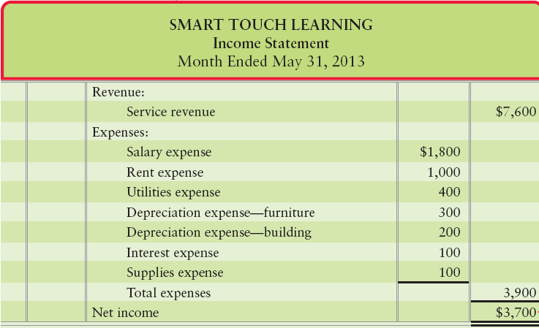
Worksheet
Compare the balances here with the Income Statement appearing next.
Income Statement
Notes:
Using the work sheet on previous slides, let’s look at how it compares to the financial statements. The income statement columns from the work sheet are on the left and the income statement is on the right. The same accounts and amounts appear, only in a different format.

Slide 22
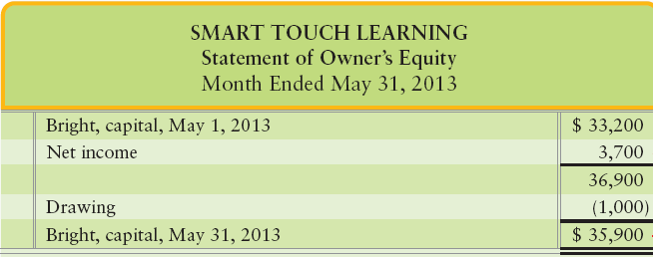

Preparing Financial Statements
Beginning capital is found in the balance sheet columns, along with Drawing
Net income is found in the income statement columns
Ending capital is computed here
Carry the ending Capital balance to the balance sheet
Notes:
The work sheet does not have columns for the statement owner’s equity. The beginning balance of Capital comes from the work sheet. The net income number can be found either on the work sheet or the income statement. The ending balance of Capital is the only amount on the financial statements that does not appear on the work sheet.

Slide 23
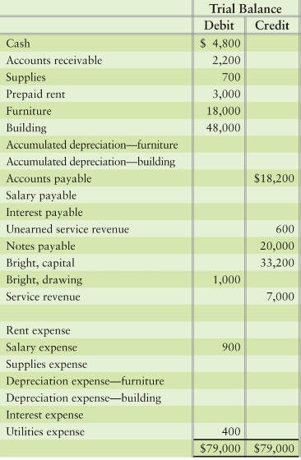
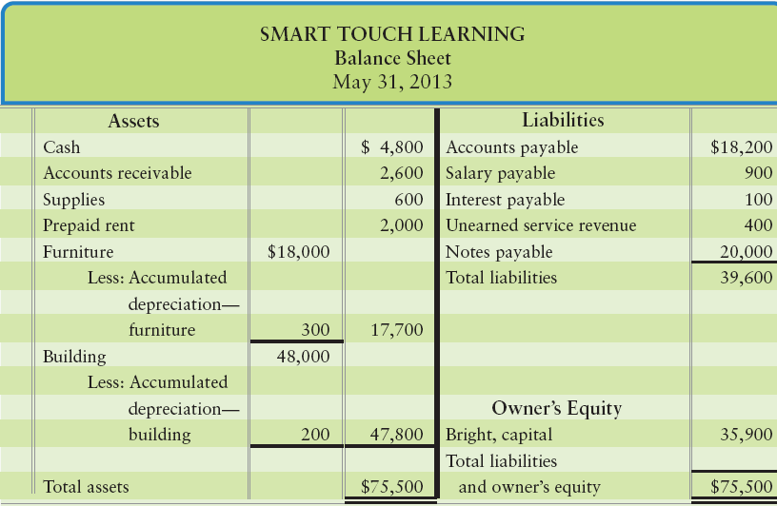
Worksheet
Balance Sheet
Compare the balances on the worksheet with the Balance Sheet appearing next.
Notes:
On this slide, we have the balance sheet columns from the work sheet on the left and the financial statement on the right. Every number except owner’s equity is the same. The owner’s equity value on the balance sheet comes from the statement of owner’s equity we just prepared. The balance sheet also has useful subtotals for the users.

Slide 24
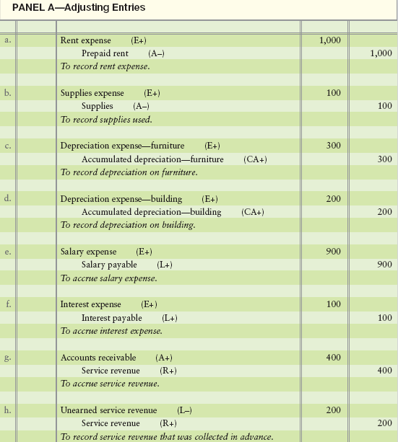
Adjusting entries are prepared after the worksheet is completed.
Notes:
The adjustments that are journalized after they are entered on the worksheet are exactly the same adjusting journal entries. Panel A of Exhibit 4-8 on Page 206 repeats Smart Touch’s adjusting entries that we journalized in Chapter 3.

Slide 25
Journalizing and Posting the Adjusting Entries
Worksheet allows small businesses to see results without posting adjusting entries
Many business adjust at end of year only
Financial statements can be prepared without adjusting accounts
Adjusting information is found on the worksheet
Notes:
Accountants can use the worksheet to prepare monthly statements without journalizing and posting the adjusting entries. A big advantage of the worksheet is that a small business can see the complete results of a period on one page. Many small companies journalize and post the adjusting entries only at the end of the year.

Slide 26
3
Close the revenue, expense, and drawing accounts
Notes:
The third learning objective is to close the revenue, expense, and dividend accounts.

Slide 27
Closing the Accounts
Occurs at the end of the period
Gets accounts ready for next period
Zeroes out revenue and expense accounts
Updates Capital to the ending balance
Four step process
Close temporary accounts
Notes:
Closing the accounts occurs at the end of the period. Closing consists of journalizing and posting the closing entries in order to get the accounts ready for the next period. The closing process zeroes out all the revenues and all the expenses in order to measure each period’s net income separately from all other periods. It also updates the Capital account balance.

Slide 28
Temporary and Permanent Accounts
Temporary
Closed at the end of the period
Revenues
Expenses
Drawing
Start next period with a zero balance
Permanent
Not closed at the end of the period
Assets
Liabilities
Capital
Ending balance carries forward to next period
Notes:
Recall that the income statement reports net income for a specific period. For example, a business’s net income for 2010 relates exclusively to 2010. For this reason, revenues and expenses are called temporary accounts. The Drawings account is also temporary and must be closed at the end of the period because it measures the withdrawals for only that one period. All temporary accounts (drawing, revenues, and expenses) are closed (zeroed). By contrast, the permanent accounts—the assets, liabilities, and Capital—are not closed at the end of the period because their balances are not used to measure income. Another way to remember which accounts are permanent is to recall that all accounts on the balance sheet are permanent accounts because they are part of the accounting equation.

Slide 29
Closing the Accounts
Step 1 – Close Revenues to Income summary account
Step 2 – Close individual Expense accounts to Income summary account
Step 3 – Close Income summary account to Capital account
Step 4 - Close Drawings account to Capital account
Notes:
Closing entries transfer the revenue, expense, and dividends balances to the Retained earnings account to ready the company’s books for the next period.
As an intermediate step, the revenues and the expenses may be transferred first to an account titled Income summary. The Income summary account summarizes the net income (or net loss) for the period by collecting the sum of all the expenses (a debit) and the sum of all the revenues (a credit).
The Income summary account is like a temporary “holding tank” that shows the amount of net income or net loss of the current period. Its balance—net income or net loss—is then transferred (closed) to Capital (the final account in the closing process).
Step 1 – Close Revenues to Income summary account. The revenue account now has a zero balance. Step 2 – Close individual Expense accounts to Income summary account. The expense accounts now have a zero balance. The Income summary account now contains the revenues and expenses and its balance represents net income or loss. Step 3 – Close Income summary account to Capital account. This moves the actual net income or loss into the Capital account. Net income increases Capital, while a net loss decreases Capital.
Step 4 – Close Drawing account to Capital account. This entry will zero out the drawing account and get it ready for a new year.

Slide 30
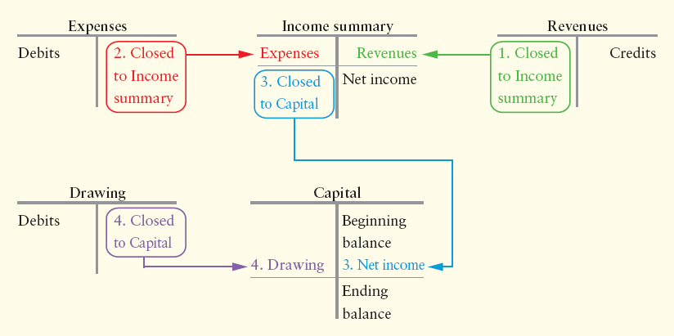
Four Closing Entries
Notes:
Make the revenue accounts equal zero via the Income summary account. This closing entry transfers total revenues to the credit side of Income summary account.
Make expense accounts equal zero via the Income summary account. This closing entry transfers total expenses to the debit side of Income summary account. The Income summary account now holds the net income or net loss of the period.
Make the Income summary account equal zero via the Capital account. This closing entry transfers net income (or net loss) to owner’s capital balance.
Make the withdrawals account equal zero via the Capital account. This entry transfers the withdrawals to the debit side of the Capital account.

Slide 31
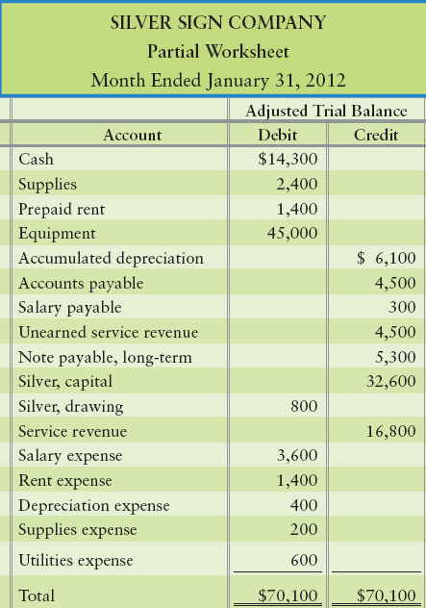
E4-18: Preparing closing entries from a partial worksheet
The adjusted trial balance from the January worksheet of
Silver Sign Company is shown:
1. Journalize Silver’s closing entries at January 31.
Notes:
Exercise 4-18 prepares closing entries from a partial worksheet.

Slide 32
E4-18: PREPARING CLOSING ENTRIES FROM A PARTIAL WORKSHEET
1. Journalize Silver’s closing entries at January 31.
Jan. | 31 | Service revenue |  | $16,800
 |  | Income summary |  |  | $16,800
 | 31 | Income summary |  | 6,200
 |  | Salary expense |  |  | 3,600
 |  | Rent expense |  |  | 1,400
 |  | Depreciation expense |  |  | 400
 |  | Supplies expense |  |  | 200
 |  | Utilities expense |  |  | 600
Notes:
The exercise continues on this slide.

Slide 33
E4-18: PREPARING CLOSING ENTRIES FROM A PARTIAL WORKSHEET
 | 31 | Income summary |  | 10,600
 |  | Silver, capital |  |  | 10,600
 | 31 | Silver, capital |  | 800
 |  | Silver, drawing |  |  | 800
2. How much net income or net loss did Silver earn for January? How can you tell?
Silver had net income of $10,600. We know this because service revenue exceeded total expenses.
Notes:
The exercise continues on this slide.

Slide 34
4
Prepare post-closing trial balance
Notes:
The fourth learning objective is to prepare a post-closing trial balance.

Slide 35
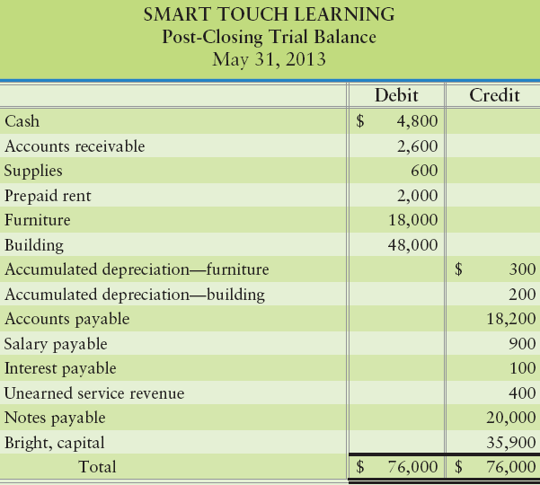
Post-Closing Trial Balance
List of permanent accounts and their balances after posting closing entries
Total debits and credits must be equal
Same accounts as on the balance sheet
Notes:
The accounting cycle can end with a post-closing trial balance. This optional step lists the accounts and their adjusted balances after closing. Only assets, liabilities, and Capital accounts appear on the post-closing trial balance. No temporary accounts—revenues, expenses, or Drawing—are included because they’ve been closed. The ledger is now up-to-date and ready for the next period. The post-closing trial balance contains the same accounts that the balance sheet contains—assets, liabilities, and Capital. Presented is the post-closing trial balance for Smart Touch Learning.

Slide 36
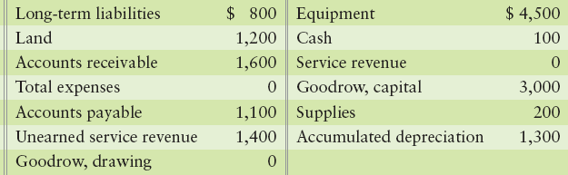
S4-8: Preparing a post-closing trial balance
After closing its accounts at July 31, 2012, Goodrow Electric Company had the following account balances:
1. Prepare Goodrow’s post-closing trial balance at July 31, 2012.
Notes:
Short Exercise 4-8 addresses preparing a post-closing trial balance.

Slide 37
S4-8: PREPARING A POST-CLOSING TRIAL BALANCE
Goodrow Electric Company
Post-Closing Trial Balance
July 31, 2012
Cash | $ 100
Accounts receivable | 1,600
Supplies | 200
Equipment | 4,500
Accumulated depreciation |  | $ 1,300
Land | 1,200
Accounts payable |  | 1,100
Unearned service revenue |  | 1,400
Long-term liabilities |  | 800
Goodrow, capital |  | 3,000
Total | $ 7,600 | $ 7,600
Notes:
The exercise continues on this slide.

Slide 38
5
Classify assets and liabilities as
current or long-term
Notes:
The fifth learning objective is to classify assets and liabilities as current or long-term.

Slide 39

Liquidity
Measures quickness of cash
How quickly an item can be converted into cash
Classified Balance Sheet
Lists assets in order of their liquidity
Current Assets
Converted to cash, sold, or used
Within one year or operating cycle
Notes:
Assets and liabilities are classified as either current or long-term to show their relative liquidity. Liquidity measures how quickly and easily an account can be converted to cash, because cash is the most liquid asset. Accounts receivable are relatively liquid because receivables are collected quickly. Supplies are less liquid, and furniture and buildings are even less so because they take longer to convert to cash. A classified balance sheet lists assets in the order of their liquidity.
Current assets will be converted to cash, sold, or used up during the next 12 months, or within the business’s operating cycle if the cycle is longer than a year. Current assets are items that will be used up in a year, like your notebook paper for this class or the change in your pocket.

Slide 40
Operating Cycle
Cash used to buy goods & services
Goods & services sold to customers
Business collects cash from customers
Notes:
The operating cycle is the time span when:
Cash is used to acquire goods and services.
These goods and services are sold to customers.
3. The business collects cash from customers.
For most businesses, the operating cycle is a few months.

Slide 41
Current Assets
Examples:
Cash
Accounts receivable
Supplies
Prepaid expenses
Inventory
Notes:
Cash, Accounts receivable, Supplies, and Prepaid expenses are current assets. Merchandising entities have another current asset–inventory. Inventory shows the cost of the goods the company holds for sale to customers.

Slide 42
Long-Term Assets
Not converted to cash within the current year or operating cycle
Categories
Plant assets
Land
Building
Furniture
Equipment
Long-term investments
Other assets
Notes:
Long-term assets are all the assets that will not be converted to cash within the business’s operating cycle. One category of long-term assets is plant assets (also called fixed assets or property, plant, and equipment). Land, Buildings, Furniture, and Equipment are plant assets. Other categories of long-term assets include Long-term investments and Other assets (a catch-all category).

Slide 43
Current Liabilities
Must be paid either with cash or goods and services within one year or operating cycle
Examples:
Accounts payable
Notes payable due within one year
Salary payable
Interest payable
Unearned revenue
Notes:
Current liabilities must be paid either with cash or with goods and services within one year, or within the entity’s operating cycle if the cycle is longer than a year. Accounts payable, Notes payable due within one year, Salary payable, Interest payable, and Unearned revenue are all current liabilities.

Slide 44
Long-Term Liabilities
Are not due within the current year or operating cycle
Examples:
Notes payable with due dates over one year
Mortgages
Notes:
All liabilities that do not have to be paid within the entity’s operating cycle are classified as long-term liabilities . Many notes payable are long-term–for example, a mortgage on a building.

Slide 45
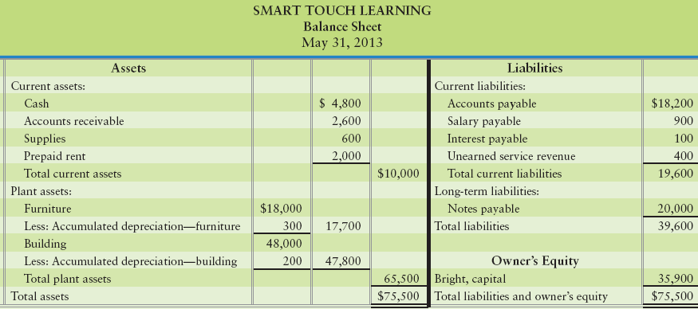
Classified Balance Sheet: Account Form
Notes:
A classified balance sheet classifies each asset and each liability as either current or long-term. Smart Touch’s classified balance sheet is shown here. Note how there are headings for current assets, plant assets, and current liabilities, with subtotals for each. This company does not have any long-term liabilities. If it did, they would appear beneath the current liabilities.
A balance sheet that lists the assets on the left and the liabilities and the equity on the right in an arrangement known as the account form.

Slide 46
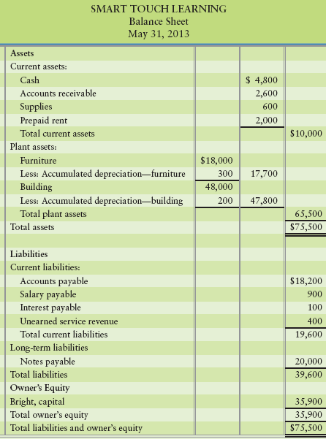
Classified Balance Sheet Report Form
Notes:
There are two formats for the balance sheet. A balance sheet that lists the assets at the left and the liabilities and the equity at the right is an arrangement known as the account form. A balance sheet that lists the assets at the top and the liabilities and stockholders’ equity on the bottom is an arrangement known as the report form. Although either form is acceptable, the report form is more popular.

Slide 47
S4-9: CLASSIFYING ASSETS AND L:IABILITIES AS CURRENT OR LONG-TERM
Account | Identification | Classification
Buildings
Accounts payable
Total expenses
Accumulated depreciation
Accrued liabilities (Salary payable)
Prepaid expenses
Service revenue
Cash
Receivables
Interest expense
Equipment
1. Identify the assets (including contra assets) and liabilities
2. Classify each asset and each liability as current or long-term
Assets
Liabilities
Neither
Assets
Liabilities
Assets
Neither
Assets
Assets
Neither
Assets
Long-term
Current
N/A
Long-term
Current
Current
N/A
Current
Current
N/A
Long-term
Notes:
Short Exercise 4-9 classifies assets and liabilities as current or long-term.

Slide 48
6
Use the current ratio and the debt ratio
to evaluate a company
Notes:
The sixth learning objective is to use the current and debt ratios to evaluate a company

Slide 49
Accounting Ratios
To measure the business’s financial position
Decision makers use financial ratios
Two widely used ratios:
Current ratio
Debt ratio
Notes:
Accounting is designed to provide information that business owners, managers, and lenders then use to make decisions. A bank considering lending money to a business must predict whether that business can repay the loan. To measure the business’s financial position, decision makers use financial ratios that they compute from the company’s financial statements.
Two of the most widely used decision aids in business are the current ratio and the debt ratio. The current ratio measures liquidity within one year by comparing current assets to current liabilities. The debt ratio measures the ability to pay liabilities in the long term by comparing all liabilities to all assets. The different ratios give different views of a company’s financial health.

Slide 50
Current Ratio
Measures a company’s ability to pay its current liabilities
Rule of thumb
Strong current ratio is 1.5
Current assets
Current liabilities
Notes:
The current ratio is computed as current assets divided by current liabilities. A company prefers to have a high current ratio because that means it has plenty of current assets to pay its current liabilities. A current ratio that has increased from the prior period indicates improvement in a company’s ability to pay its current debts. The rule of thumb states that a strong current ratio is 1.50, which indicates that the company has $1.50 in current assets for every $1.00 in current liabilities. A current ratio of 1.00 is considered low and somewhat risky.

Slide 51
Debt Ratio
Indicates the proportion of a business’s assets that are financed with debt
Measures business’s ability to pay its debts
Rule of thumb:
Below 60% is considered safe
Total liabilities
Total assets
Notes:
The debt ratio is computed as total liabilities divided by total assets. The debt ratio indicates the proportion of a company’s assets that are financed with debt. A low debt ratio is safer than a high debt ratio. Why? Because a company with low liabilities usually has low required payments and is less likely to get into financial difficulty. The rule of thumb for the debt ratio is that below 60% is considered safe for most businesses, as it indicates that the company owes only 60 cents for every $1.00 in total assets. A debt ratio above 0.80, or 80%, borders on high risk.

Slide 52
S4-11: COMPUTING THE CURRENT AND DEBT RATIOS
Heart of Texas Telecom has these account balances at December 31, 2012:
1. Compute Heart of Texas Telecom’s current ratio and debt ratio.
2. How much in current assets does Heart of Texas Telecom have for every dollar of current liabilities that it owes?
Note payable, long-term $ 7,800 Accounts payable $ 3,700
Prepaid rent 2,300 Accounts receivable 5,700
Salary payable 3,000 Cash 3,500
Service revenue 29,400 Depreciation expense 6,000
Supplies 500 Equipment 15,000
Current ratio | = | Total current assets
 |  | Total current liabilities
= | $12,000
 | 6,700
= | 1.79
Debt ratio | = | Total liabilities
 |  | Total assets
= | $14,500
 | $27,000
= | 0.54
Heart of Texas Telecom has $1.79 of current assets for every dollar of current liabilities that it owes.
Notes:
Short Exercise 4-11 focuses on the current ratio and the debt ratio.

Slide 53
Chapter 4 Summary
The worksheet is a tool that puts the whole accounting process in one place. Remember that debits = credits in the first three sets of columns. Columns 7-8 and 9-10 (income statement and balance sheet) debits do not equal credits until you post the net income or net loss for the period.
The formal financial statements yield the same net income or loss that is shown on the worksheet.
Notes:
The worksheet is a tool that puts the whole accounting process in one place. Remember that debits = credits in the first three columns. Columns 4 and 5 (income statement and balances) debits do not equal credits until you post the net income or net loss for the period.
The formal financial statements yield the same net income or loss that is shown on the worksheet.

Slide 54
Chapter 4 Summary
Closing the accounts is just like starting a new baseball game. The score is 0-0. All temporary account balances are zero after closing.
The post-closing trial balance contains the same accounts that the balance sheet contains—assets, liabilities, Common stock, and Retained earnings.
Notes:
Closing the accounts is just like starting a new baseball game. The score is 0-0. All temporary account balances are zero after closing.
The post-closing trial balance contains the same accounts that the balance sheet contains—assets, liabilities, Common stock, and Retained earnings.

Slide 55
Chapter 4 Summary
Classification means dividing assets and liabilities between those that will last less than a year (current) and those that will last longer than a year (long-term).
The classified balance sheet still represents the accounting equation and must balance (Assets = Liabilities + Equity).
Notes:
Classification means dividing assets and liabilities between those that will last less than a year (current) and those that will last longer than a year (long-term).
The classified balance sheet still represents the accounting equation and must balance (Assets = Liabilities + Equity).

Slide 56
Chapter 4 Summary
The current ratio measures liquidity within one year by comparing current assets to current liabilities.
The debt ratio measures the ability to pay liabilities in the long term by comparing all liabilities to all assets.
The different ratios give different views of a company’s financial health.
Notes:
The current ratio measures liquidity within one year by comparing current assets to current liabilities. The debt ratio measures the ability to pay liabilities in the long term by comparing all liabilities to all assets. The different ratios give different views of a company’s financial health.

Slide 57

Notes:
Do you have any questions?

Slide 58
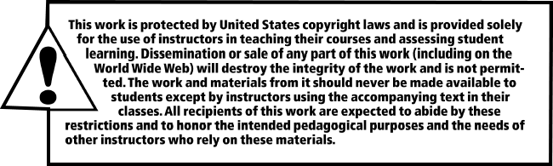
Copyright
All rights reserved. No part of this publication may be reproduced, stored in a retrieval system, or transmitted, in any form or by any means, electronic, mechanical, photocopying, recording, or otherwise, without the prior written permission of the publisher. Printed in the United States of America.

Slide 59
.
References / Resources
https://www.iedunote.com/worksheet
https://www.iedunote.com/worksheet
https://www.thebalancesmb.com/closing-entries-as-part-of-the-accounting-cycle-393003
https://www.myaccountingcourse.com/accounting-cycle/post-closing-trial-balance
https://www.toppr.com/guides/accounting-and-auditing/preparation-of-final-accounts-of-sole-proprietor/classification-of-assets-and-liabilities/
https://www.thebalancesmb.com/what-is-the-current-ratio-and-how-do-you-measure-it-393218

